Slide 1
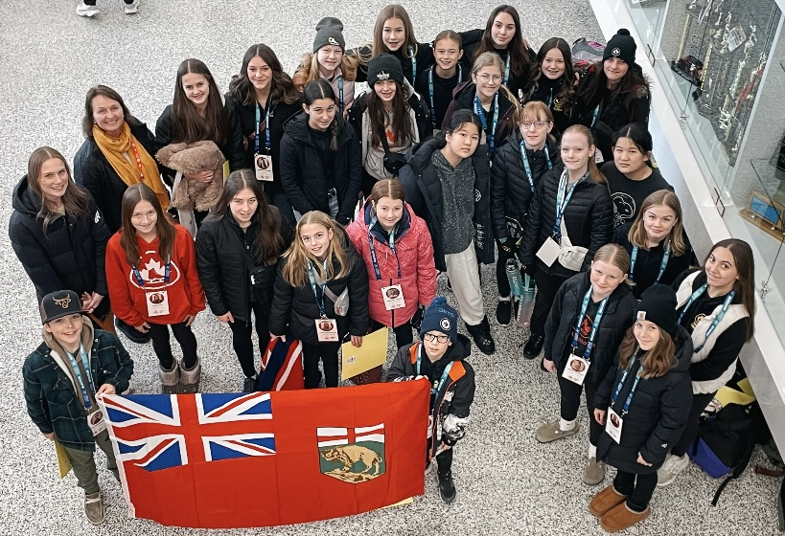

2026-2027 Criteria & Programming

Slide 2
Criteria: Age Requirement: Must be 13 and Under as of July 1st ,2026
,

Slide 3
Criteria: * Achieve the Skate Canada assessment for the level * Complete and Submit a Yearly Training Plan by September 15th , 2026
Criteria as set out by Skate Canada for:
SINGLES – Pre Juvenile, Juvenile and STAR 5 and Up
As well as Pre Novice or Novice who have not yet attained the Internal Qualifying Minimum Score
Criteria as set out by Skate Canada:
DANCE- one partner must have a STAR 5 Dance assessment
PAIRS - one partner must have a STAR 5 Free Skate assessment
Synchro – must have passed a STAR 5 in any discipline and on a Team that receives a report card
Submit a Yearly Training Plan (YTP) to the Technical Director by September 15th , 2026 skate.td@sportmanitoba.ca

Slide 4
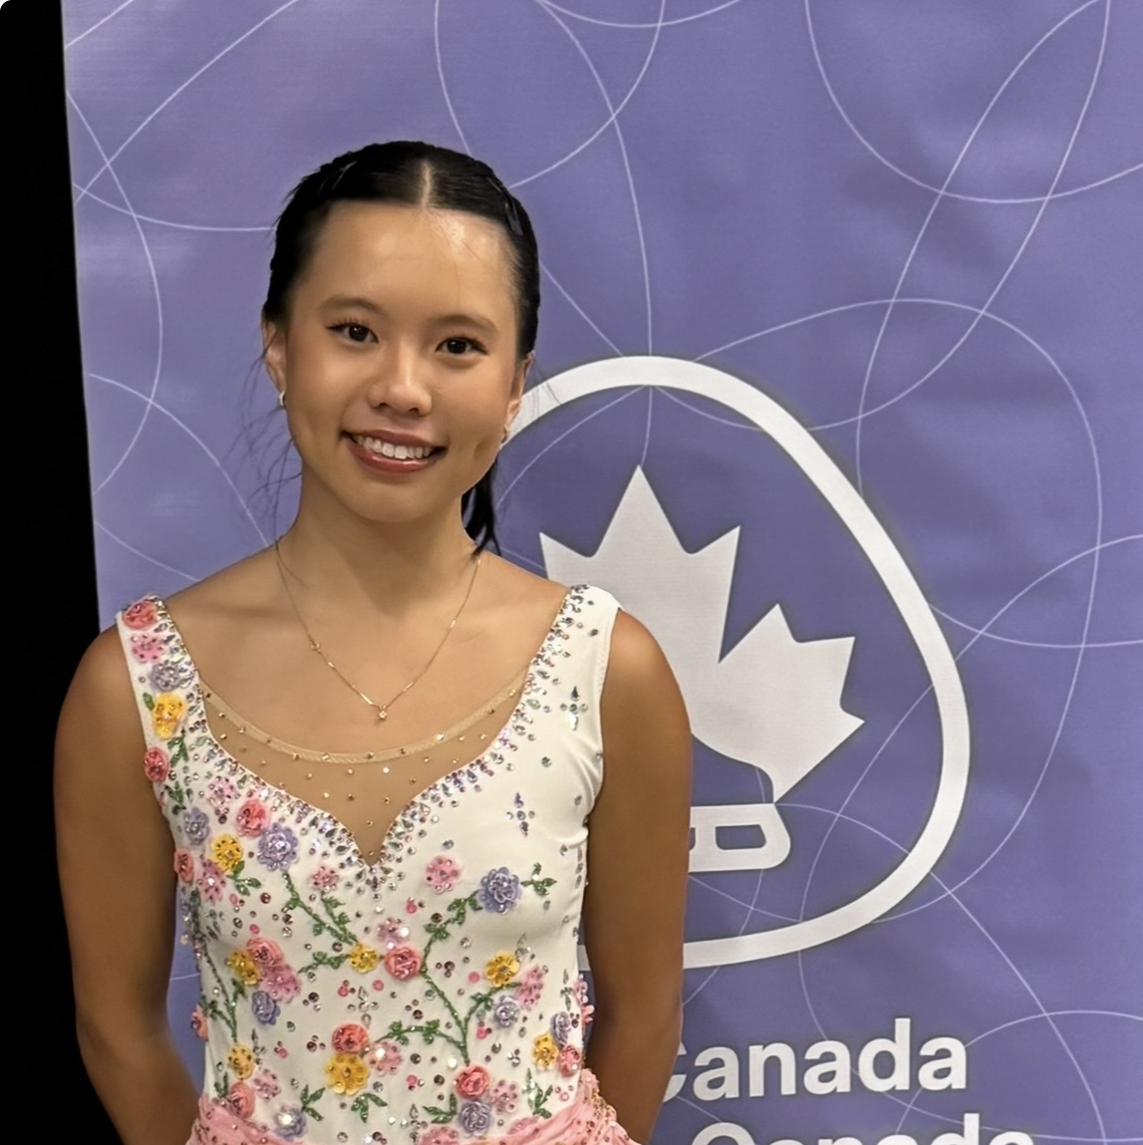
2026 -2027 Programming

Slide 5
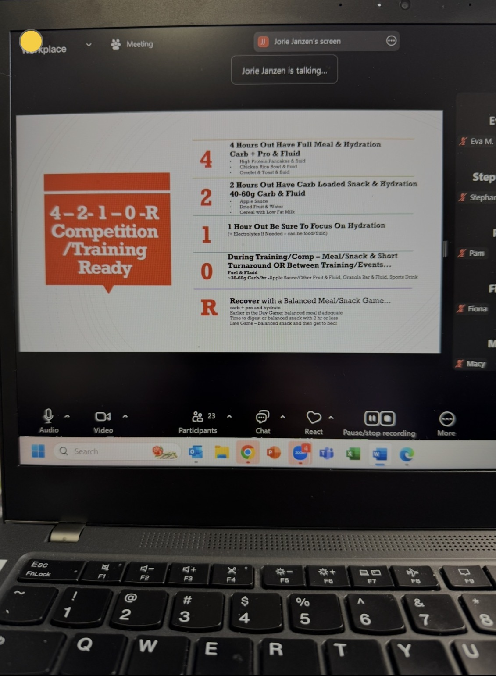
VIRTUAL SESSIONS: Our goal is to provide inclusive quality programming according to the Ltd Our presenters are some of the best in the world in their area of expertise.

Slide 6
2026-2027 VIRTUAL SESSIONS:
1. | July 21 | 7:00pm | Interruption Rules | -with Karen
2. | July 22 | 7:00pm | Nutrition - Fueling for Practice & Competition | -with Jorie
3. | Aug 10 -16 |  | Sport Psych Intake forms – sent out by Angie | -with Angie
4. | Aug 23 | 7:00pm | Goal Setting | -with Angie
5. | Sept 2 | 7:00pm | Jump Theory | -with Kevin
6. | Sept 16 | 7:00pm | Jump Class -pending | -with Kevin
7. | Sept 19 | 10:00am | Skating skills | -with Yebin
8. | Sept 20 | 7:00pm | Integrating mindfulness and acceptance into training/ competition | -with Angie
9. | Oct 7 | 7:00pm | Turning pressure into power -performing at your best at competition | -with Angie
10. | *Oct 10 OR Nov 21 | 10:00am | Skating skills - pending | -with Yebin
11. | Oct 18 | 7:00pm | Nutrition Facts and Snacks | -with Jorie
10. | *Oct 10 OR Nov 21 | 10:00am | Skating skills - pending | -with Yebin
12. | March 17 | 7:00pm | Season Reflections | -with Angie
:

Slide 7

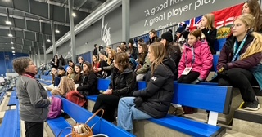
Team Project: at Skate Canada Junior & Senior Challenge on Saturday Nov.28th in Winnipeg

Slide 8
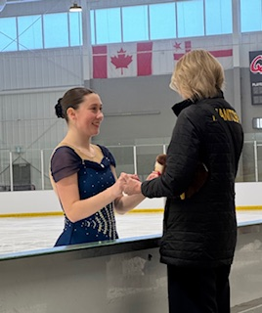
NEW: Out of Province Competition support: for Skaters who participate in the Sask skate Competition on October 2nd to 4th in Regina Following the event Submit your competition report card and you will receive a competition Grant of $150.00

Slide 9

Each Team TOBA member will receive a Team toba sweatshirt!
Team Swag:

Slide 10


New: Parent Package We hear you! From your feedback we have selected the top 3 requests for additional information and assistance. These sessions are open to Parents or Guardians of Skaters on both Team MANITOBA and Team TOBA
This Photo by Unknown Author is licensed under CC BY-SA

Slide 11
NEW: Parent Package:
Uplifter 101
This session will help you navigate your way through Uplifter.
- Date TBA
How to Fill Out a Planned Program Content Sheet
This session will provide you with the What, Why, and How to fill out the PPC sheet.
- Date TBA
What to Say and Not Say in the Car
Angie, our Mental Performance Consultant, will host a parent meeting to discuss strategies to help you best support your athlete
-Sunday September 20th by ZOOM at 8:15pm.

Slide 12

If you have any questions or would like further clarification on Team TOBA, please reach out to Tammy at skate.td@sportmanitoba.ca

