Slide 1
Centralized Assessments Information Session

Slide 2
Dates
1.) Warren December 13
2.) Killarney January 18
3.) Morden February 7
4.) Minnedosa March 15
5.) Stonewall April 12

Slide 3
How to Submit an Assessment
Complete the Submission Form on our website
Community – Clubs/Schools – Assessments ‘Learn More’ button
Who completes it
Deadlines
Form is open now
Submissions will NOT be accepted by any other means
PPC for Artistic and Free Skate must be submitted at the time of submission

Slide 4
How to Submit a Pull
Complete the Pull Form on our website
Community – Clubs/Schools – Assessments ‘Learn More’ button
Who completes it
Deadlines at 9:00 AM on date of deadline
Form is open now
Pulls will NOT be accepted by any other means

Slide 5
Payment
Invoices sent after Pull Deadline
Due 5 business days BEFORE Assessment day (ie 9:00 AM on Monday)
Failure to remit payment:
Assessment will be pulled, family will be notified
Payment continues to be required
Skater will NOT be permitted to submit another assessment until payment received
Etransfer option will be available for families upon request

Slide 6
Fees
Skate Canada assessment fee of $12.00 per assessment
Ice fee (varies pending on location and how many assessments)
MBLL grant to hopefully cover all costs for officials' expenses

Slide 7
Schedules
Skaters from a club/school will be grouped together to minimize the impact of travel
More than one club may be grouped together where there are smaller numbers, and for the benefit of skaters not skating assessments back to back
Clubs/schools closest to the assessment location will be booked earlier in the day to help with travel for those farthest away
This is all pending the assessments submitted

Slide 8
Club/School Requirements
Must bring the music for all assessments from the club on a playable device
Volunteer from club must play the music for the assessments
Skate MB will have all Assessment Sheets ready for skaters

Slide 9
Refunds
There are no refunds after the pull date, even for Medical reasons
Everyone shares the cost of the ice and we have to cover expenses
A skater who has an assessment that is pending the successful completion of another assessment that day, and does not complete the pre-requisite will be refunded their Skate Canada assessment fee of $12. No refunds for ice can be provided.
Example, skater has 1 dance assessment in STAR 8 to complete before being able to take the STAR 9A dance. The STAR 8 assessment does not pass and they are unable to take the STAR 9A dance. They will receive their $12 back.

Slide 10
Deadlines
Location | Date | Submissions | Pulls due by 9 AM | Payment due by 9 AM
Warren | December 13 | November 17 | November 24 | December 8
Killarney | January 18 | December 22 | December 29 | January 12
Morden | February 7 | January 12 | January 19 | February 2
Minnedosa | March 15 | February 17 | February 23 | March 9
Stonewall | April 12 | March 16 | March 23 | April 6
** Pull Deadlines are always AFTER the previous assessment day**

Slide 11
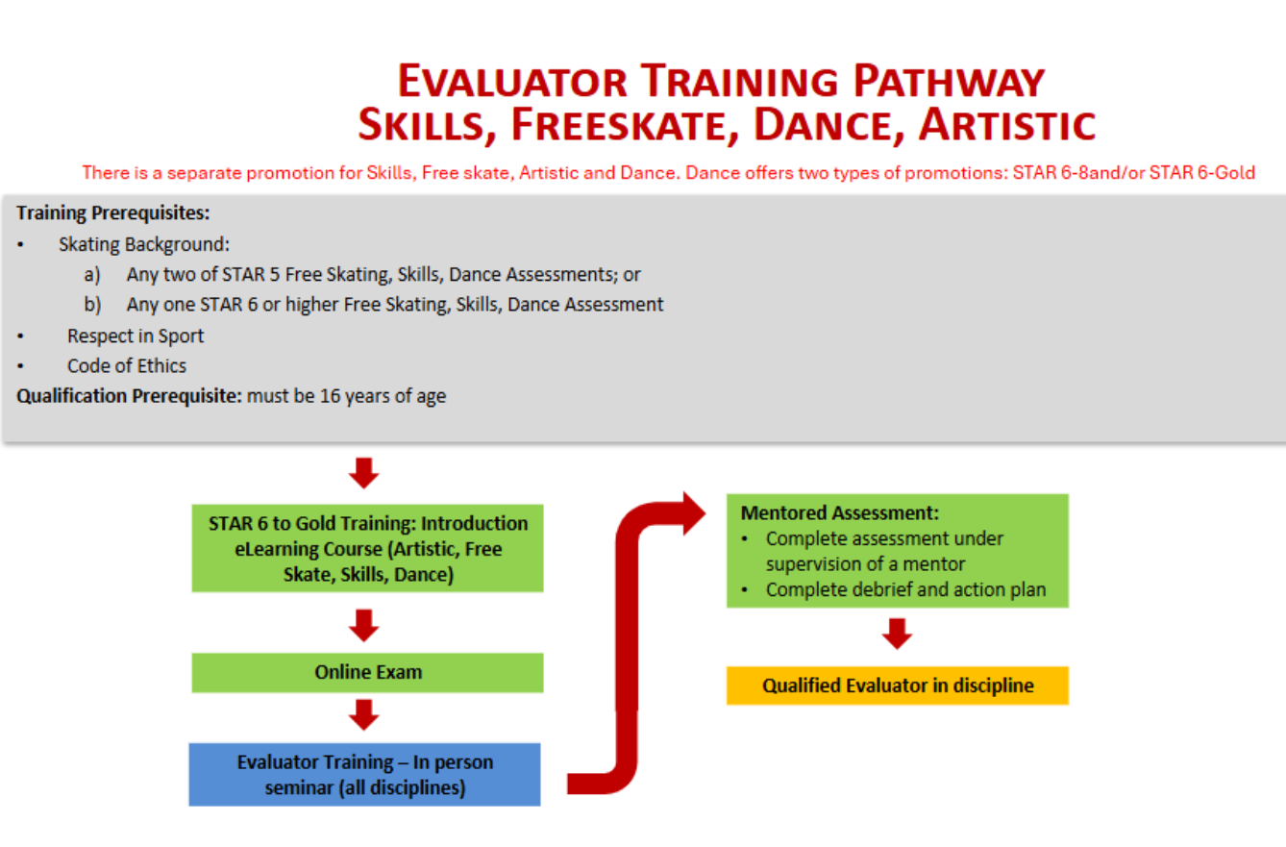
Can start training at 15, can evaluate beginning at 16
STAR 6-Gold Soft Skills February 21st – Evaluator Training

Slide 12

Questions

